Slide 1
Yashwantrao Chavan College Of Science Karad
Project Name :- Well Health GYM Application
Student Name :- Gaikwad Anisha Anil
Guide Name :- Miss. A. G. Jirange.

Slide 2
Introduction To System
What is System:
System involves co-ordinating and overseeing the work activities of others so that their activities are completed efficiently and effectively.
GYM Application is the process of analysing, producing and evaluating it is different way of promoting a product, service. Digital GYM Application System requires certain core values to be deployed to every element, process and achieve effective and efficient result.
Shops can be described as a unit of producing different items that are used in day to day life. It can be based on the transaction type and items in GYM. The no of transactions involves in system of GYM depends upon the size of the items and exercising items which is required.

Slide 3
About project:
Well Health GYM Application is used to handle all the activity related to the billing in organization that uses this software. Many GYM works on very big Management and it is very hard to manage this manual work. To manage all the billing related activity, we have developed this software. To get easy manipulation in the GYM System owner should have strong network contact of Customers in daily routine. To make a successful owner needs to provide good quality of exercise to the customer. In present system GYM trainer has to do all management work manually. GYM manager keep all transactions information on papers. There is no system to check payment register and this task are very time consuming and tiresome. Keeping all these problems in mind we have developed this system helps the given organization to manage their paper work computerized and they can also retrieve report of last transaction they have completed.

Slide 4

SYSTEM DIAGRAM
Data Flow Diagram (DFD)
Zero level (Context Level Diagram):

Slide 5
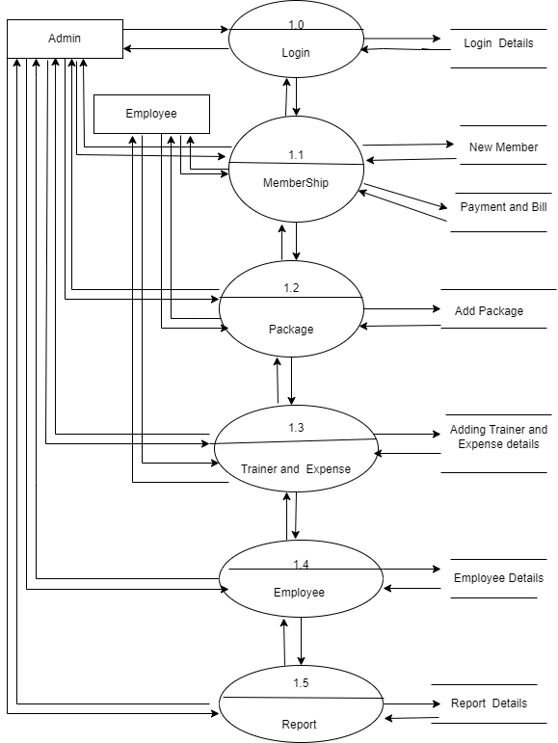
First Level Diagram:

Slide 6
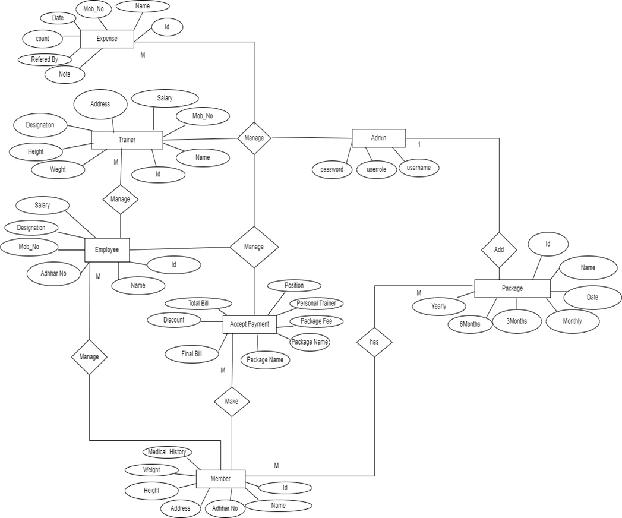
Entity Relationship Diagram (ERD)

Slide 7
DATABASE DESIGN Table Name:- login Description:- It Store Login Information. Primary key:- No

Slide 8
Table Name:- Employee_Details Description:- It Store Employee Details. Primary key:- Emp_ID

Slide 9
Table Name:- Member_Details Description:-To Store Member Details.

Slide 10
Table Name:- Payment_Details Description:-It Stores Payment Details

Slide 11
Table Name:- Package_Details Description:-To Store Package Details.

Slide 12
Table Name:- Trainer_Details Description:-To Stores Trainer Details

Slide 13
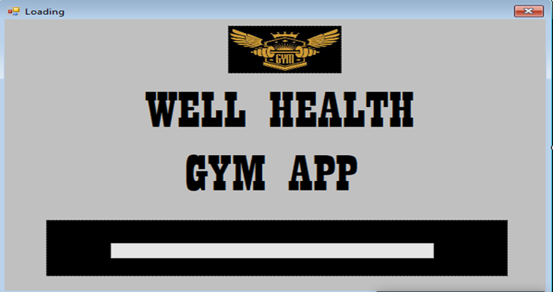
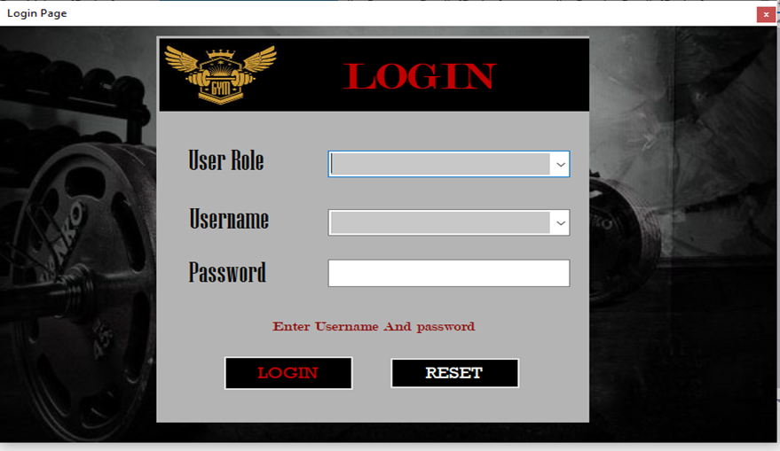
INPUT/OUTPUT DESIGN Loading Login Page

Slide 14
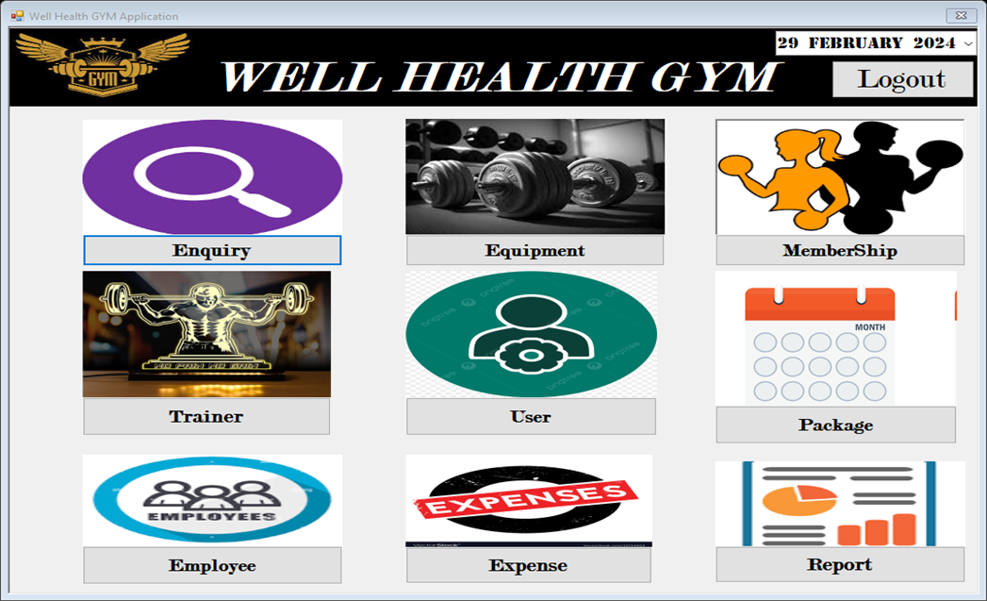
Home Page -

Slide 15
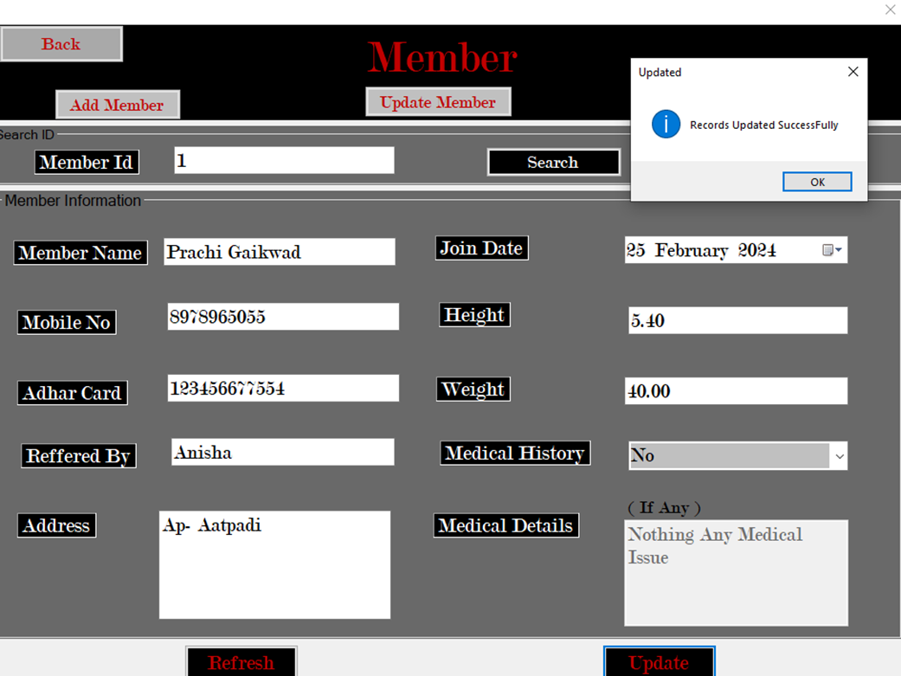
Member Page -

Slide 16
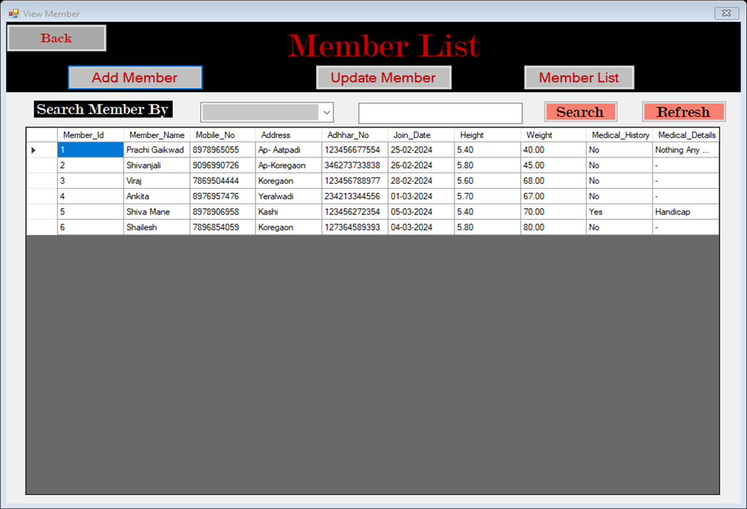
Member List Page-

Slide 17
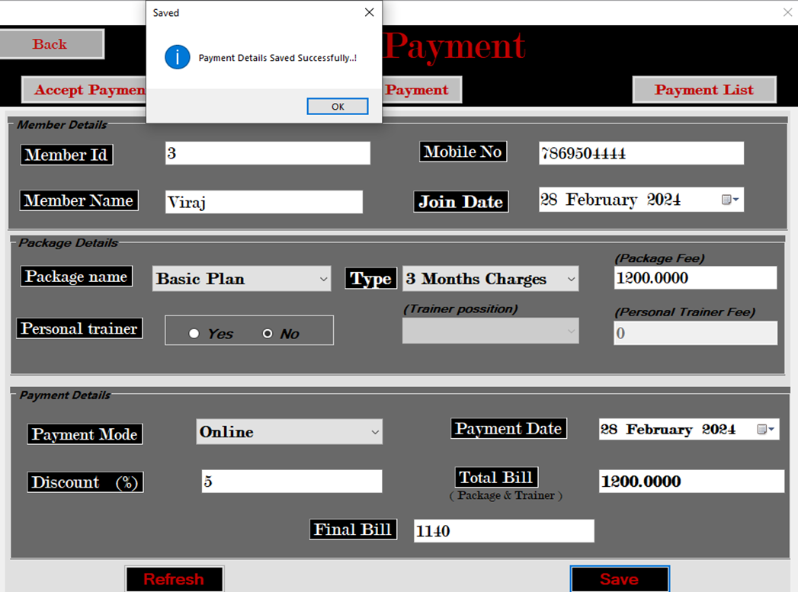
Payment Page-

Slide 18
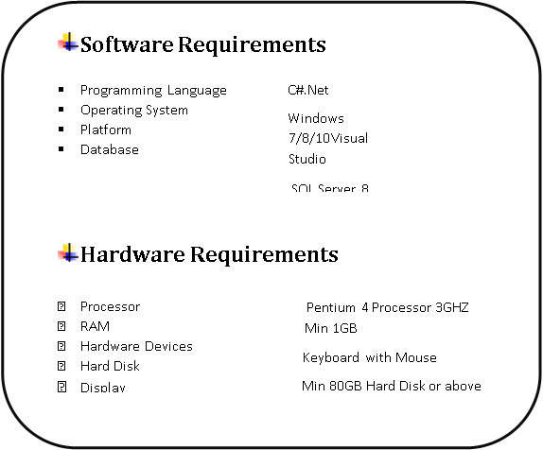
SYSTEM REQUIREMENTS

Slide 19
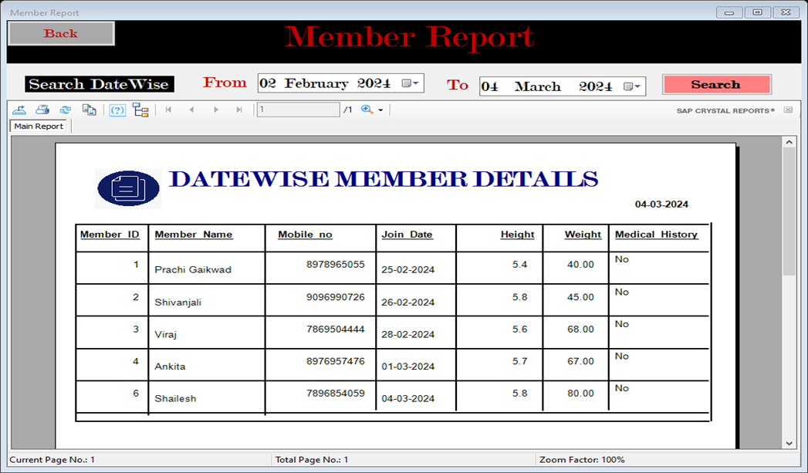
SCREENS AND REPORTS

Slide 20
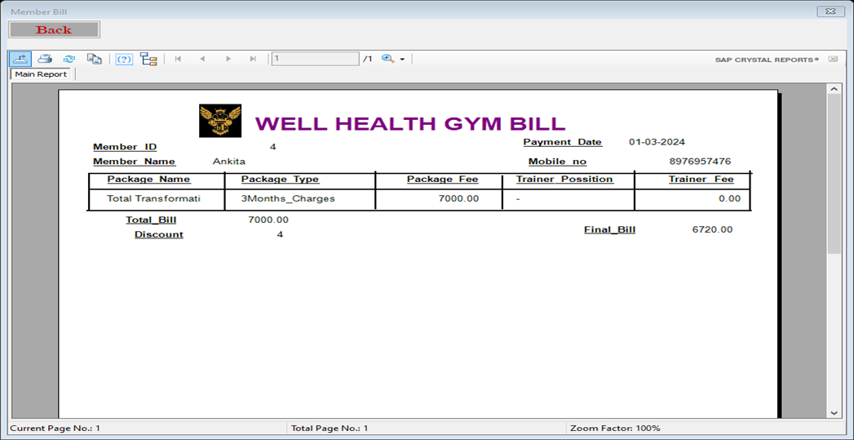

Slide 21
FUTURE ENHANCEMENT
The system could reduce the manual work & physical entities of the system.
We will include more functionality as per the user requirements .
In Future due to increase in records of database file, data redundancy occurs.
More modules can be included in future.
The system can be further enhanced by proposing an advance Facilities.
We want to improved our home page, as it is the main thing which attracts all users.
We can host the platform on online server to make it accessible worldwide
Development and launching of Website and refining existing services and adding more service.

Slide 22
CONCLUSION
The project titled as “Well Health GYM Application” is a Desktop based application. This Project Is developed using C# .Net as front end and MS SQL for database in back end . This software provides facility for reporting of Member Information, Trainer Information etc. We are developing such types of the module which help to reduce the GYM work manually & it helps to save the time of the user. considerable reduce the corruption in the transport department keep the GYM Data document safely.
This software is developed with scalability in mind. Additional modules can be easily added when necessary. The software is developed with modular approach. All modules in the system have been tested with valid data and invalid data and everything work successfully. Thus the system has fulfilled all the objectives identified and is able to replace the existing system. The application has been tested with live data and has provided a successful result. Hence the software has proved to work efficiently

Slide 23
THANK YOU

